Slide 1
Kubernetes Monitoring
WorkshopPlus – Kubernetes Tech Briefing

Slide 2
Conditions and terms of use
© Microsoft Corporation. All rights reserved.
You may use these training materials solely for your personal internal reference and non-commercial purposes. You may not distribute, transmit, resell or otherwise make these training materials available to any other person or party without express permission from Microsoft Corporation. URL’s or other internet website references in the training materials may change without notice. Unless otherwise noted, any companies, organizations, domain names, e-mail addresses, people, places and events depicted in the training materials are for illustration only and are fictitious. No real association is intended or inferred. THESE TRAINING MATERIALS ARE PROVIDED “AS IS”; MICROSOFT MAKES NO WARRANTIES, EXPRESS OR IMPLIED IN THESE TRAINING MATERIALS¹

Slide 3

Learning Units covered in this Module
 | Azure Monitor for AKS
 | Kubernetes Logging and Key Metrics
 | AKS Loggings and Metrics
 | Azure Monitor managed service for Prometheus and Azure Managed Grafana​

Slide 4
Objectives
After completing this Learning, you will be able to:
Understand….
Monitoring AKS cluster and Application.
Logging and key metrics
OpenSource Solution
Azure Monitor managed service for Prometheus and Azure Managed Grafana​

Slide 5
Azure Monitor with AKS

Slide 6
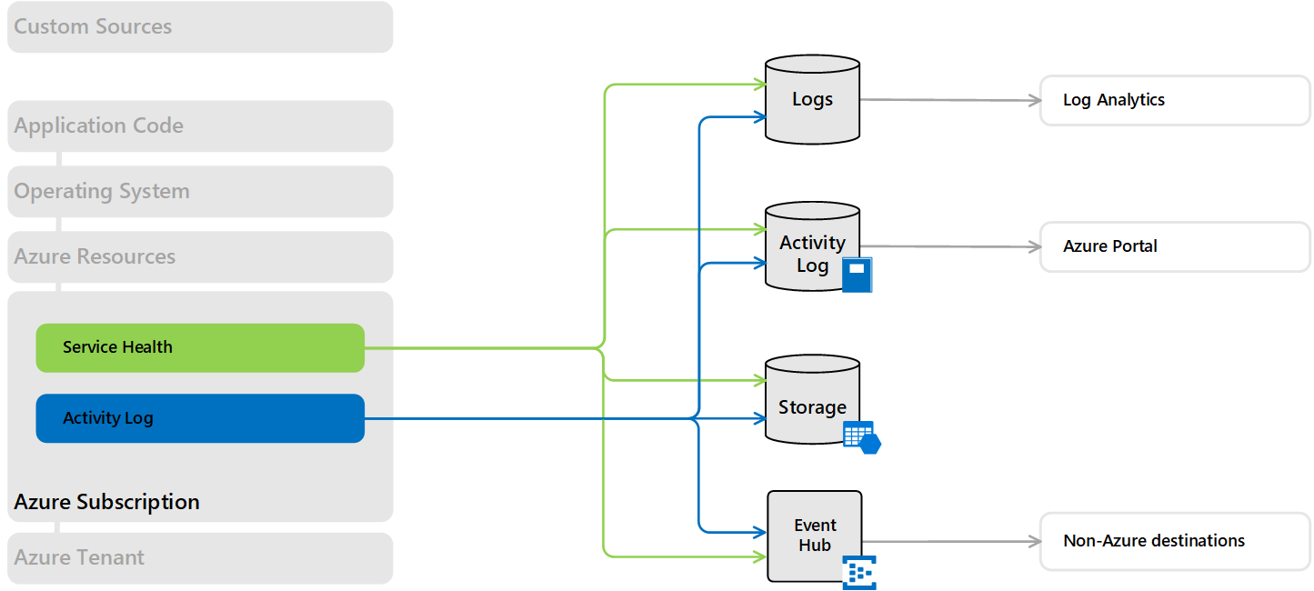
Observability - Azure Monitor Subscription Level
Notes:
Talk about how Azure monitor works in a general sense at the subscription level. We don't need to go in too much detail just a general piece about sub level monitoring and logging.
Monitors subscription level changes user activity. Azure Diagnostic Settings can record various operational issues, such as who created, deleted, or updated a VM, and when security group rules were updated. This feature is vital for security, troubleshooting, and compliance in cloud environments.

Slide 7
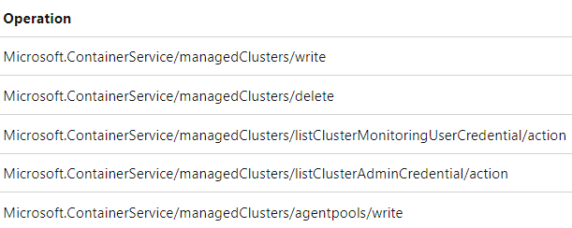
Observability - AKS Activity Log
Activity Log
Subscription-level events that track operations for each Azure resource, for example, creating a new resource or starting a virtual machine. Activity log events are automatically generated and collected for viewing in the Azure portal. You can create a diagnostic setting to send the activity log to Azure Monitor Logs.
Notes:
Activity log is used to track information such as when a cluster is created or had its configuration change. Briefly talk about the different operation types listed in the slide.

Slide 8
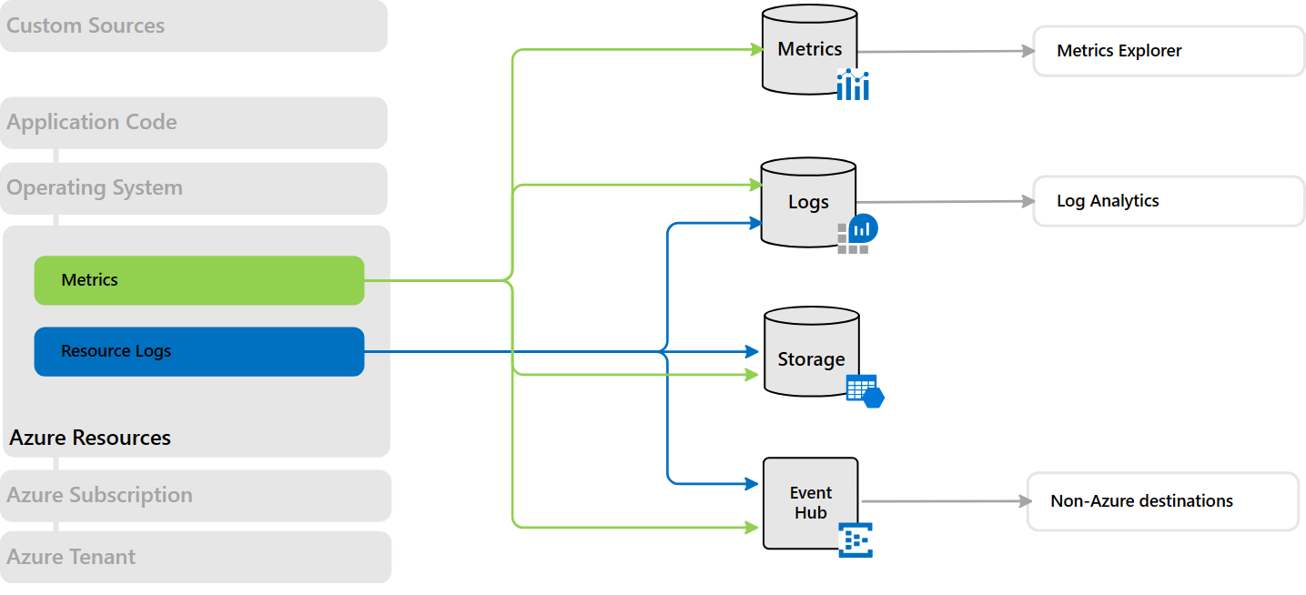
Observability - Azure Monitor Resource Level
Notes:
Collects metrics and logs from actions performed at the resource level. They can include information about the operations performed on the resource, the status of those operations, and other details that help you understand the health and performance of the resource.

Slide 9
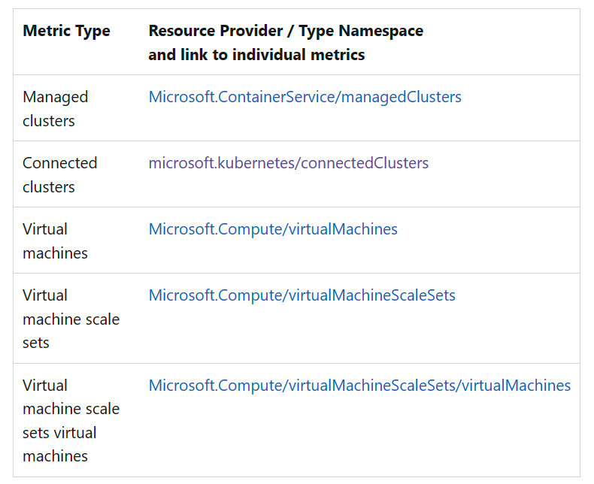
Observability - AKS Metrics
Metrics
Numerical values that are automatically collected at regular intervals and describe some aspect of a resource at a particular time. Platform metrics are automatically generated and collected in Azure Monitor Metrics.
Notes:
Different Azure monitor metric types that are collected. These are some of the metrics that are collected when enabled on AKS.

Slide 10
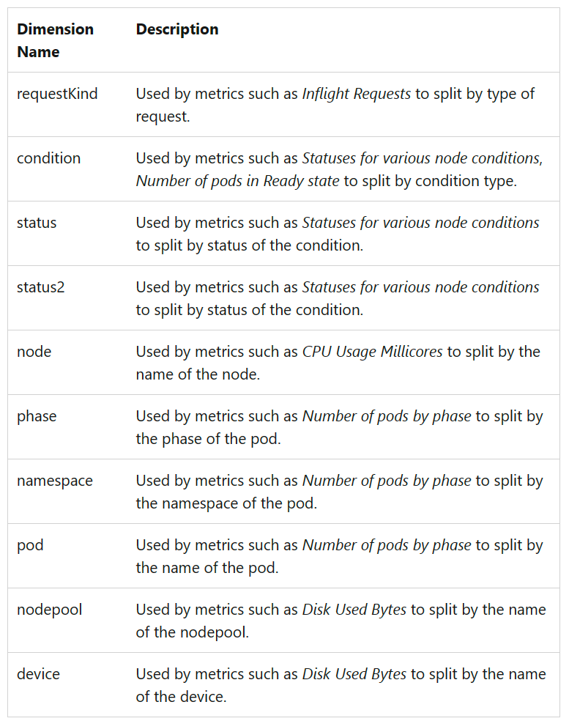
Observability - AKS Metrics (cont.)
Metrics
Numerical values that are automatically collected at regular intervals and describe some aspect of a resource at a particular time. Platform metrics are automatically generated and collected in Azure Monitor Metrics.
Notes:
Examples of different dimension names when collected in Azure monitor for AKS. Highlight a few of them like Namespace, Nodepool, etc

Slide 11
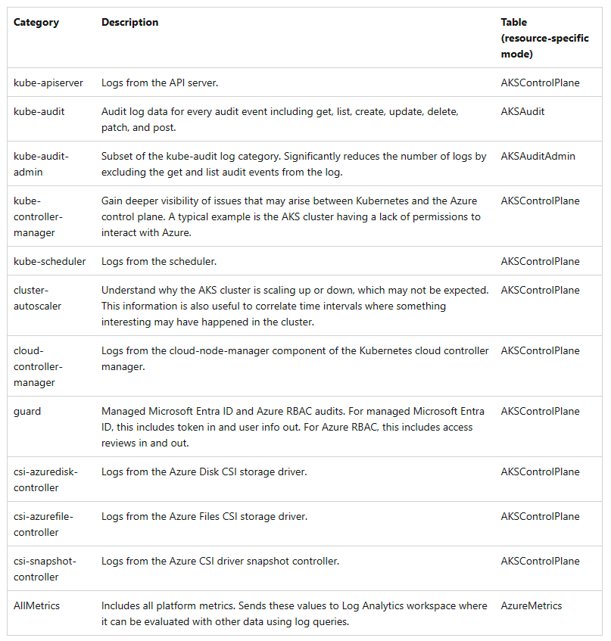
Observability - Resource level - AKS
Resource Logs
Provide insight into operations that were performed by an Azure resource. Operation examples might be getting a secret from a key vault or making a request to a database. Resource logs are generated automatically, but you must create a diagnostic setting to send them to Azure Monitor Logs.
Notes:
Different available resource level logs for AKS. Discuss what they are used for and which ones are most commonly enabled.

Slide 12
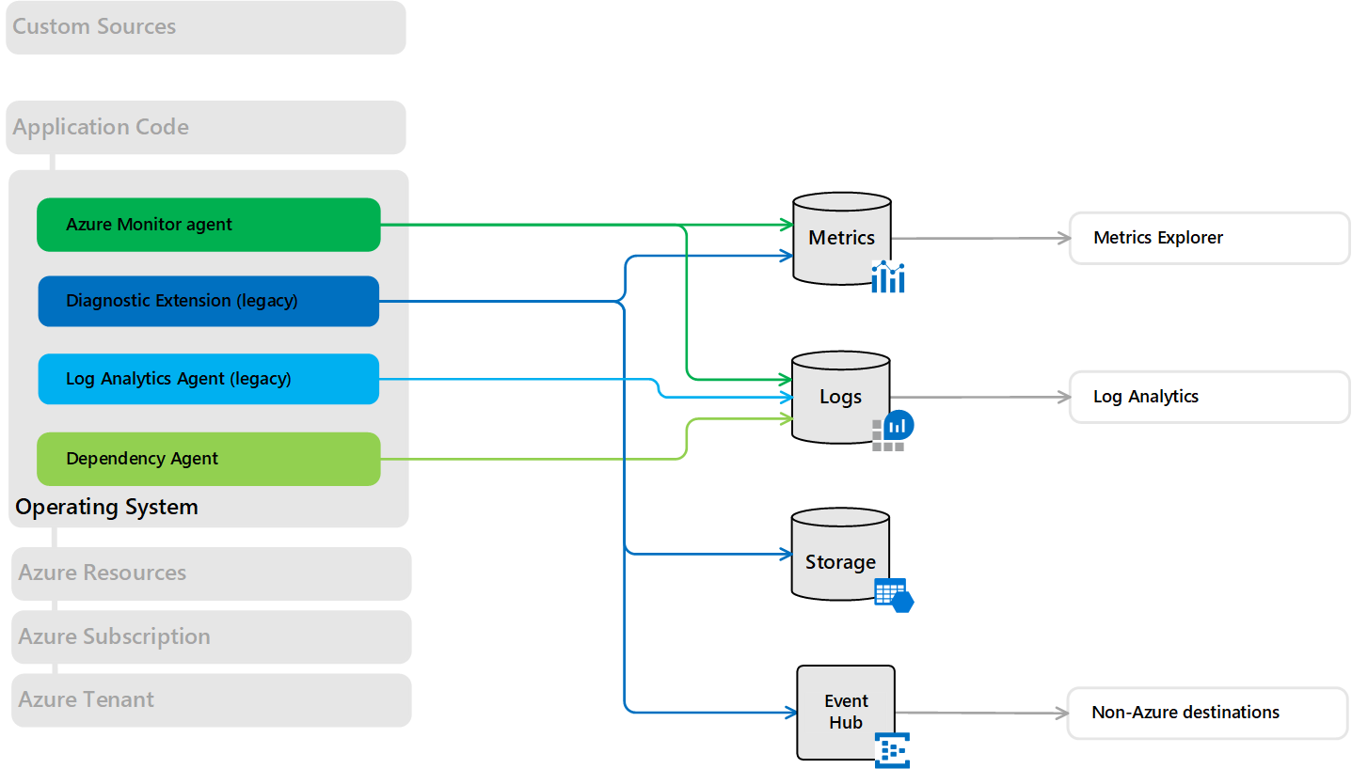
Observability - Azure Monitor OS Level
Notes:
Azure Monitor implements OS level monitoring when Container insights is enabled. It collects CPU, Memory, disk usage, node count, etc

Slide 13
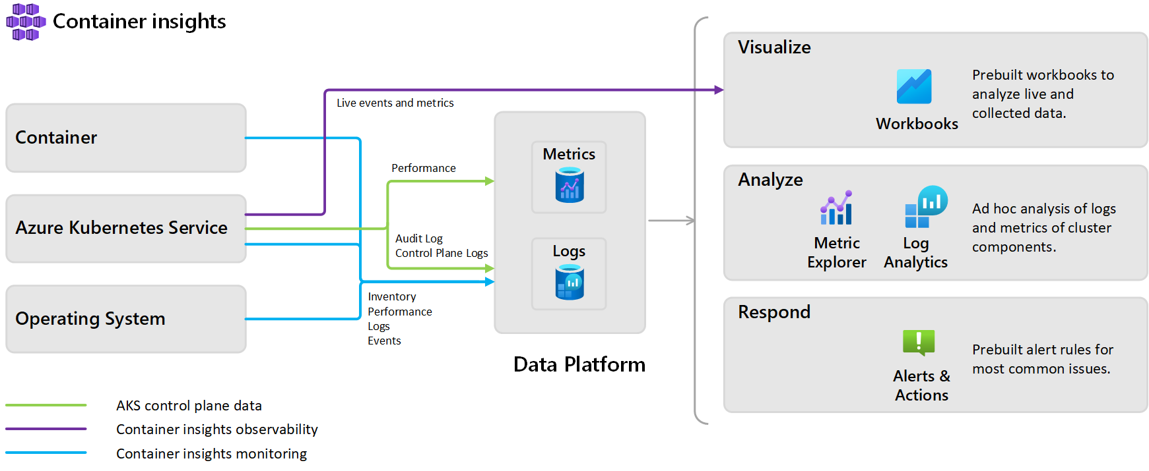
Observability - Azure Monitor Container Insights
Notes:
Talk about what container insights is and how it works. How it compares and works with managed prometheous and grafana

Slide 14
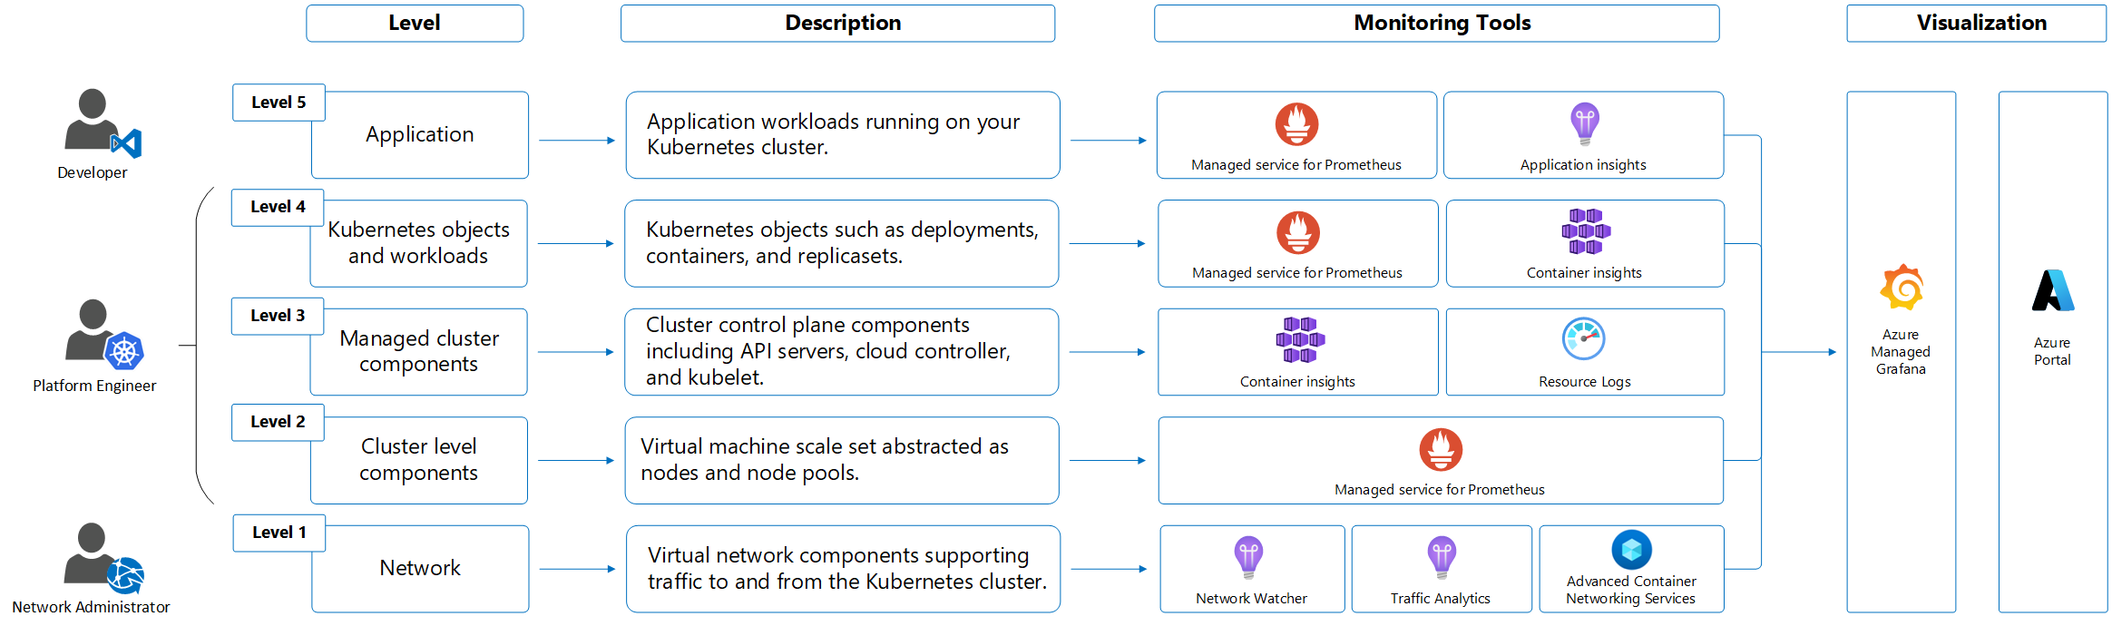
The 5 levels of monitoring in AKS

Slide 15
Observability - AKS
Control Plane
  # of API requests, audit logs
Node infrastructure
  CPU, Memory, Disk capacity and I/Os, Network bandwidth usage
Kubernetes layer
  Deployment, pod, service
Application layer
  Log, request latency, errors

Slide 16
Kubernetes Logging & Metrics

Slide 17
Kubernetes Logging Basics
Collect logs from all application pods and send them to a centralized logging solution
In non-K8S environment, an agent is installed in each VM
Running an agent (sidecar) in each pod is not a viable solution as logging is a resource intensive operation
Need a solution that runs in each node that can collect logs from each of the pods (from the node) and stream to a centralized logging solution
Daemonset is an ideal solution to address this

Slide 18
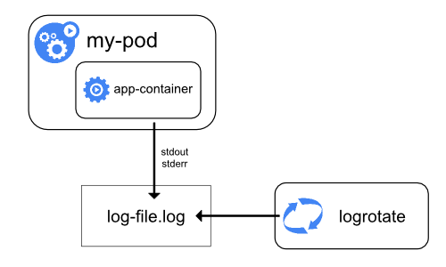
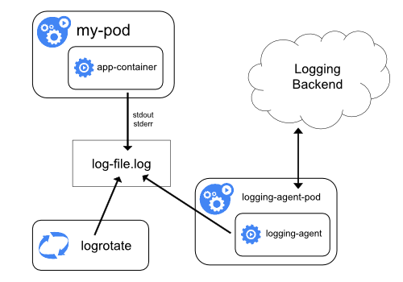
Kubernetes Logging Basics
application writes to stdout
AKS uses this pattern
Images from Kubernetes.io
Notes:
Firstly talk about how the application writes to stdout and how a log collection utilty can use that and how log files can be collected.
Then focus on how AKS uses it log collection agent to collect logs

Slide 19
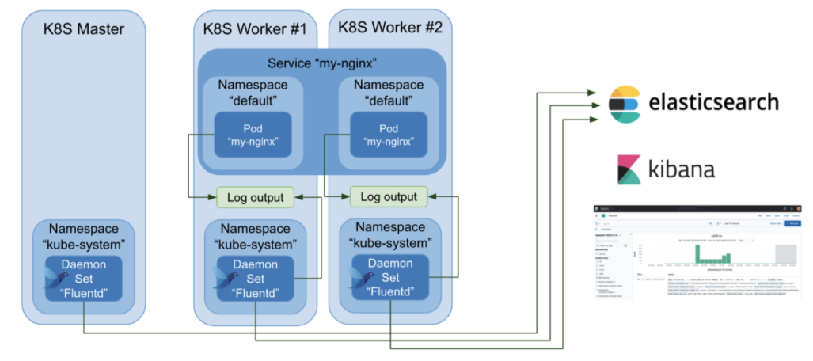
Kubernetes Logging with Fluentbit
Logging : Fluentd with Kubernetes (fluentbit.io)
Image from fluentbit.io
Notes:
Optional slide. Demonstrating how a log collection utility like fluentbit can be used to send logs to a variety of sources.

Slide 20
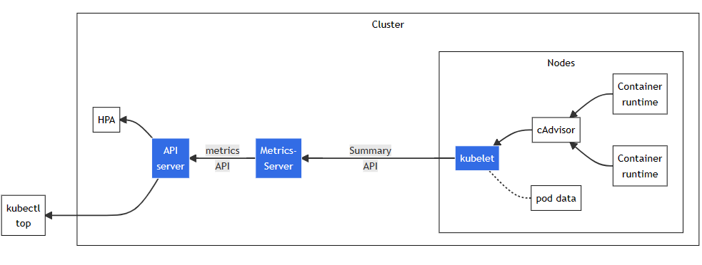
Containers and Kubernetes Metrics Basics
Containers and Cgroups
cAdvisor is a daemon collects, aggregates and reports resource usage of running containers
CRI spec expects container runtime to implement this capability now
Image from Kubernetes.io

Slide 21
Kubernetes Metrics Server
Despites its name, its only purpose is to support cluster operations such as autoscaling
Etcd is not an option as its designed to collect, aggregate and store 25000 metrics per second
Scheduling and autoscaling are core service provided by Kubernetes thus requires a first party metrics collection and serving
HPA, VPA use metrics API served by metrics server
Collects metrics every 15 seconds
Collected metrics in memory
Not responsible for forwarding metrics to third-party tools

Slide 22
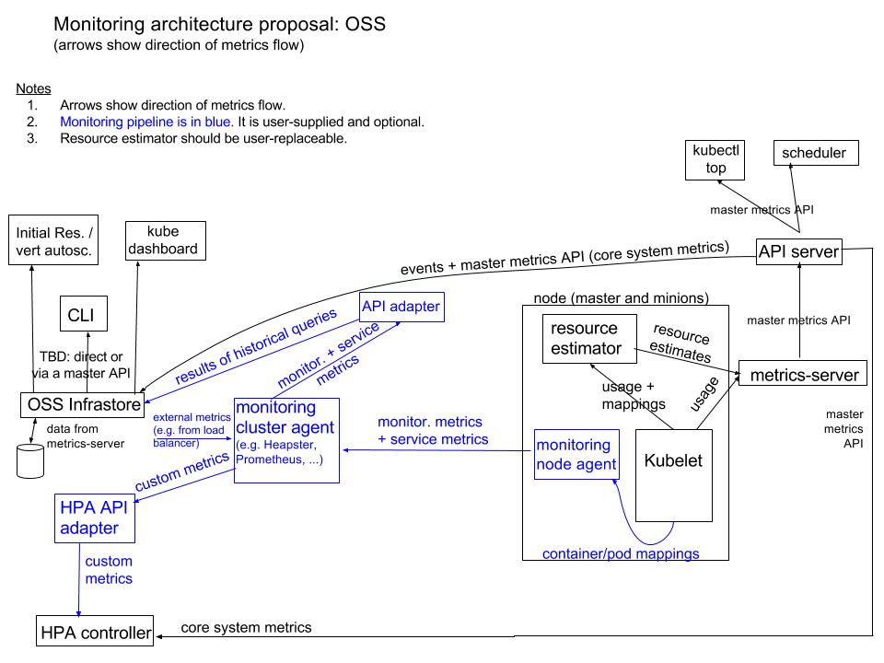
Kubernetes Metrics Server
from Kubernetes.io
Notes:
Summray:
Monitoring is split into two pipelines:
A core metrics pipeline consisting of Kubelet, a resource estimator, a slimmed-down Heapster called metrics-server, and the API server serving the master metrics API. These metrics are used by core system components, such as scheduling logic (e.g. scheduler and horizontal pod autoscaling based on system metrics) and simple out-of-the-box UI components (e.g. kubectl top). This pipeline is not intended for integration with third-party monitoring systems.
A monitoring pipeline used for collecting various metrics from the system and exposing them to end-users, as well as to the Horizontal Pod Autoscaler (for custom metrics) and Infrastore via adapters. Users can choose from many monitoring system vendors, or run none at all. In open-source, Kubernetes will not ship with a monitoring pipeline, but third-party options will be easy to install. We expect that such pipelines will typically consist of a per-node agent and a cluster-level aggregator.
Core metrics pipeline
The core metrics pipeline collects a set of core system metrics. There are two sources for these metrics
Kubelet, providing per-node/pod/container usage information (the current cAdvisor that is part of Kubelet will be slimmed down to provide only core system metrics)
a resource estimator that runs as a DaemonSet and turns raw usage values scraped from Kubelet into resource estimates (values used by scheduler for a more advanced usage-based scheduler)
These sources are scraped by a component we call metrics-server which is like a slimmed-down version of today's Heapster. metrics-server stores locally only latest values and has no sinks. metrics-server exposes the master metrics API. (The configuration described here is similar to the current Heapster in “standalone” mode.) Discovery summarizer makes the master metrics API available to external clients such that from the client's perspective it looks the same as talking to the API server.
Core (system) metrics are handled as described above in all deployment environments. The only easily replaceable part is resource estimator, which could be replaced by power users. In theory, metric-server itself can also be substituted, but it'd be similar to substituting apiserver itself or controller-manager - possible, but not recommended and not supported.
Eventually the core metrics pipeline might also collect metrics from Kubelet and Docker daemon themselves (e.g. CPU usage of Kubelet), even though they do not run in containers.
The core metrics pipeline is intentionally small and not designed for third-party integrations. “Full-fledged” monitoring is left to third-party systems, which provide the monitoring pipeline (see next section) and can run on Kubernetes without having to make changes to upstream components. In this way we can remove the burden we have today that comes with maintaining Heapster as the integration point for every possible metrics source, sink, and feature.
Infrastore
We will build an open-source Infrastore component (most likely reusing existing technologies) for serving historical queries over core system metrics and events, which it will fetch from the master APIs. Infrastore will expose one or more APIs (possibly just SQL-like queries -- this is TBD) to handle the following use cases
initial resources
vertical autoscaling
oldtimer API
decision-support queries for debugging, capacity planning, etc.
usage graphs in the Kubernetes Dashboard
In addition, it may collect monitoring metrics and service metrics (at least from Kubernetes infrastructure containers), described in the upcoming sections.
Monitoring pipeline
One of the goals of building a dedicated metrics pipeline for core metrics, as described in the previous section, is to allow for a separate monitoring pipeline that can be very flexible because core Kubernetes components do not need to rely on it. By default we will not provide one, but we will provide an easy way to install one (using a single command, most likely using Helm). We described the monitoring pipeline in this section.
Data collected by the monitoring pipeline may contain any sub- or superset of the following groups of metrics:
core system metrics
non-core system metrics
service metrics from user application containers
service metrics from Kubernetes infrastructure containers; these metrics are exposed using Prometheus instrumentation
It is up to the monitoring solution to decide which of these are collected.
In order to enable horizontal pod autoscaling based on custom metrics, the provider of the monitoring pipeline would also have to create a stateless API adapter that pulls the custom metrics from the monitoring pipeline and exposes them to the Horizontal Pod Autoscaler. Such API will be a well defined, versioned API similar to regular APIs. Details of how it will be exposed or discovered will be covered in a detailed design doc for this component.
The same approach applies if it is desired to make monitoring pipeline metrics available in Infrastore. These adapters could be standalone components, libraries, or part of the monitoring solution itself.
There are many possible combinations of node and cluster-level agents that could comprise a monitoring pipeline, including cAdvisor + Heapster + InfluxDB (or any other sink)
cAdvisor + collectd + Heapster
cAdvisor + Prometheus
snapd + Heapster
snapd + SNAP cluster-level agent
Sysdig
As an example we'll describe a potential integration with cAdvisor + Prometheus.
Prometheus has the following metric sources on a node:
core and non-core system metrics from cAdvisor
service metrics exposed by containers via HTTP handler in Prometheus format
[optional] metrics about node itself from Node Exporter (a Prometheus component)
All of them are polled by the Prometheus cluster-level agent. We can use the Prometheus cluster-level agent as a source for horizontal pod autoscaling custom metrics by using a standalone API adapter that proxies/translates between the Prometheus Query Language endpoint on the Prometheus cluster-level agent and an HPA-specific API. Likewise an adapter can be used to make the metrics from the monitoring pipeline available in Infrastore. Neither adapter is necessary if the user does not need the corresponding feature.
The command that installs cAdvisor+Prometheus should also automatically set up collection of the metrics from infrastructure containers. This is possible because the names of the infrastructure containers and metrics of interest are part of the Kubernetes control plane configuration itself, and because the infrastructure containers export their metrics in Prometheus format.

Slide 23
AKS Logging & Metrics

Slide 24
Logging in AKS
Control Plane
  AKS resource log to LAW or Eventhub or storage account
Node infrastructure
  Container Insights – VM level logs
Kubernetes layer
  Container Insights to LAW or Eventhub or storage account for logs. This takes care of pod (app) logs
Application layer
  App Insights

Slide 25
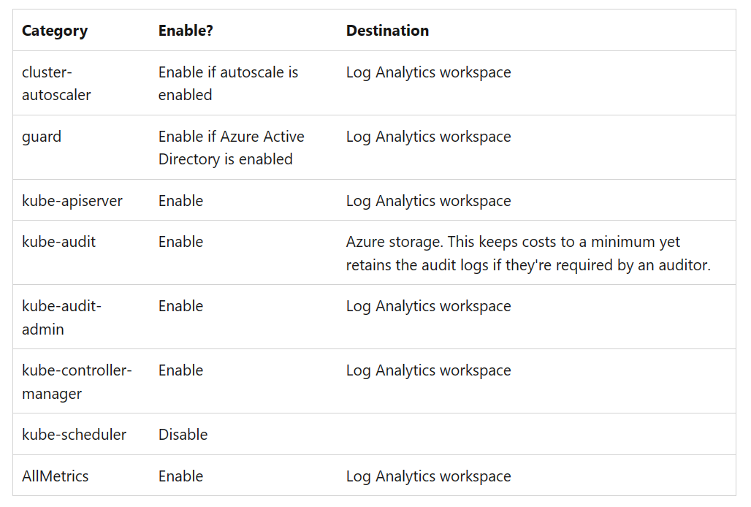
AKS Resource log (Control Plane) and Kubelet
Container Insights doesn’t collect or use
Enable with ‘Diagnostic settings’
Use recommendations and turn on logs
Alternatively, use third party solutions with EH/Storage integration
Kubelet logs

Slide 26
AKS Kubernetes layer Logs
Azure Monitor container insights is the primary log collection solution for AKS to collect stdout/stderr logs
Container insights stores its data in a Log Analytics workspace
Agent collection can be configured with ConfigMap
Supports cost optimization settings (in preview)

Slide 27
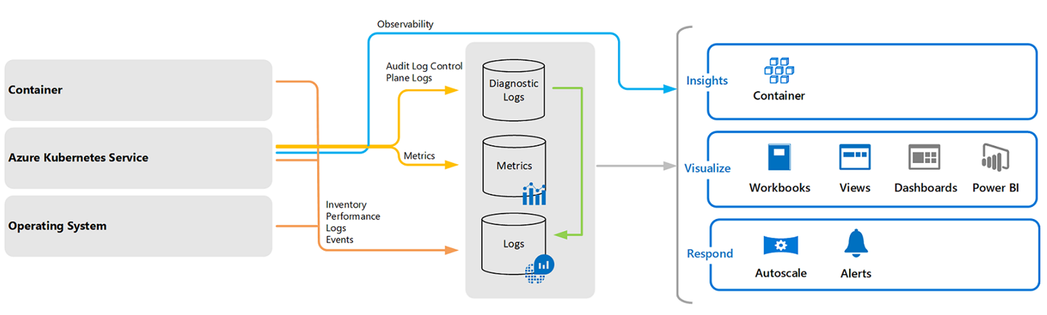
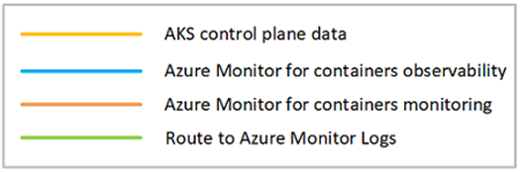
Metrics in AKS
Metrics server – installed
Container Insights - Optional
Azure Monitor managed service for Prometheus - Optional
Managed Grafana - Optional

Slide 28
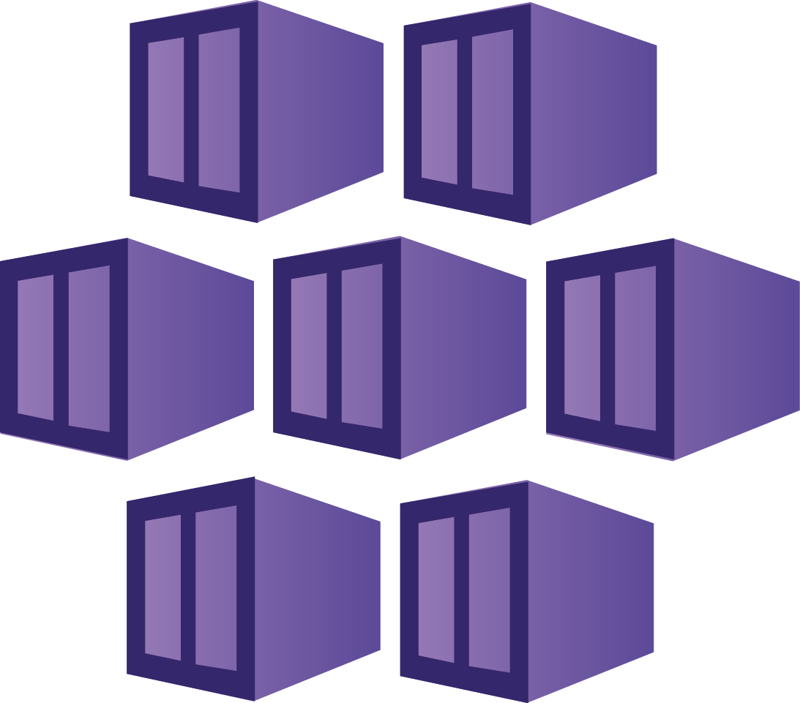
Cluster level
Infrastructure such as nodes/VM, their usage
Nodes health, performance such as disk capacity, I/O, etc.
Cluster level view

Slide 29
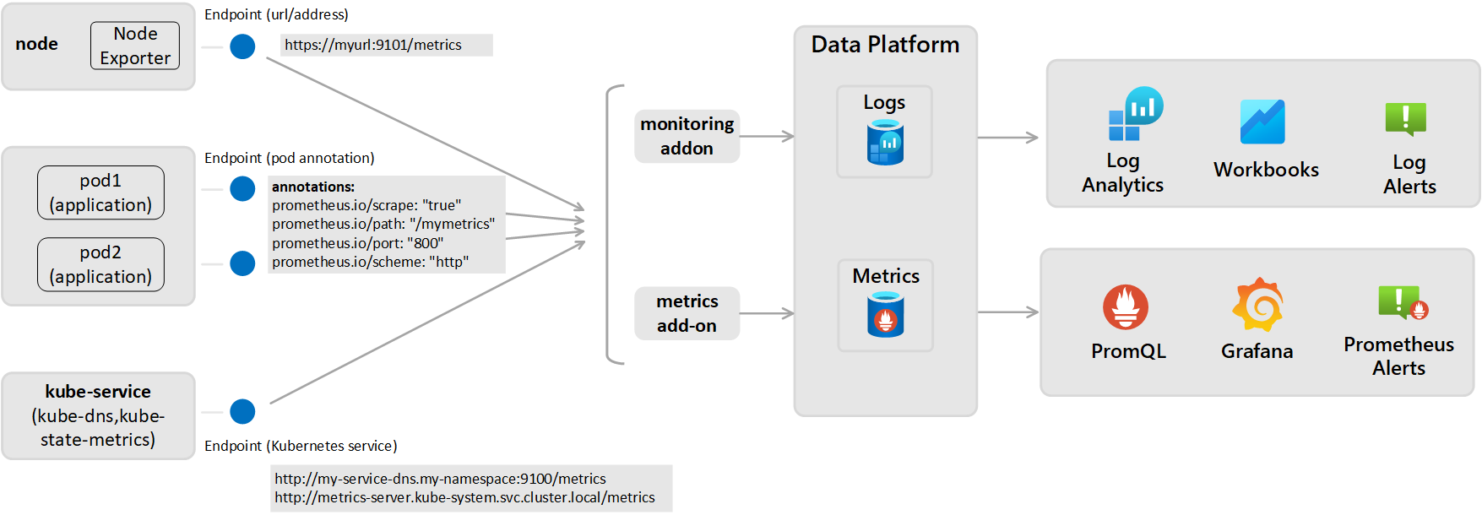
Kubernetes Objects and workloads
Containerized agent scrapes Prometheus endpoint – presented in Container Insights and Azure Monitor (Log analytics queries, alerts)
(or) Scrapes and send to Azure Monitor managed serv. For Prometheus

Slide 30
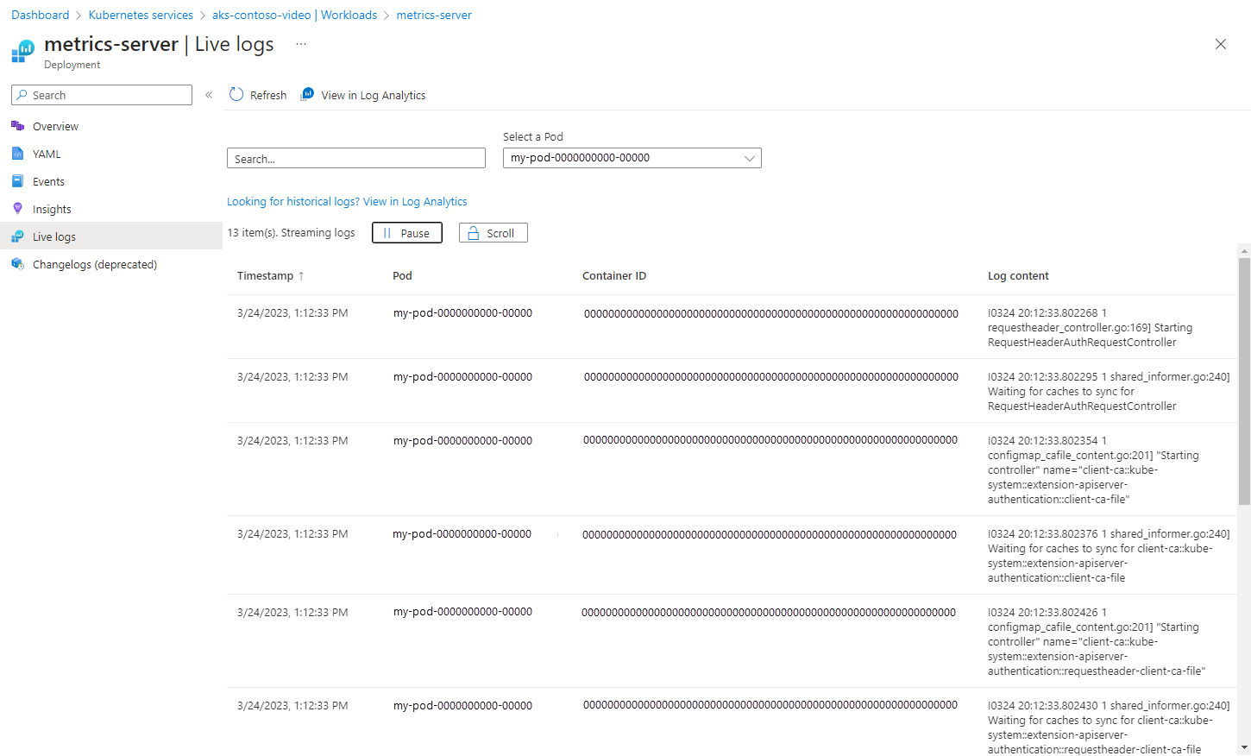
AKS Live logs (logs, events and metrics)
Supports to view live logs from Azure portal (Container Insights is not required)
Supports logs, events and metrics
Requires auth
Live logs are ephemeral (meaning deleted after closed / not retained)
Not for private clusters

Slide 31
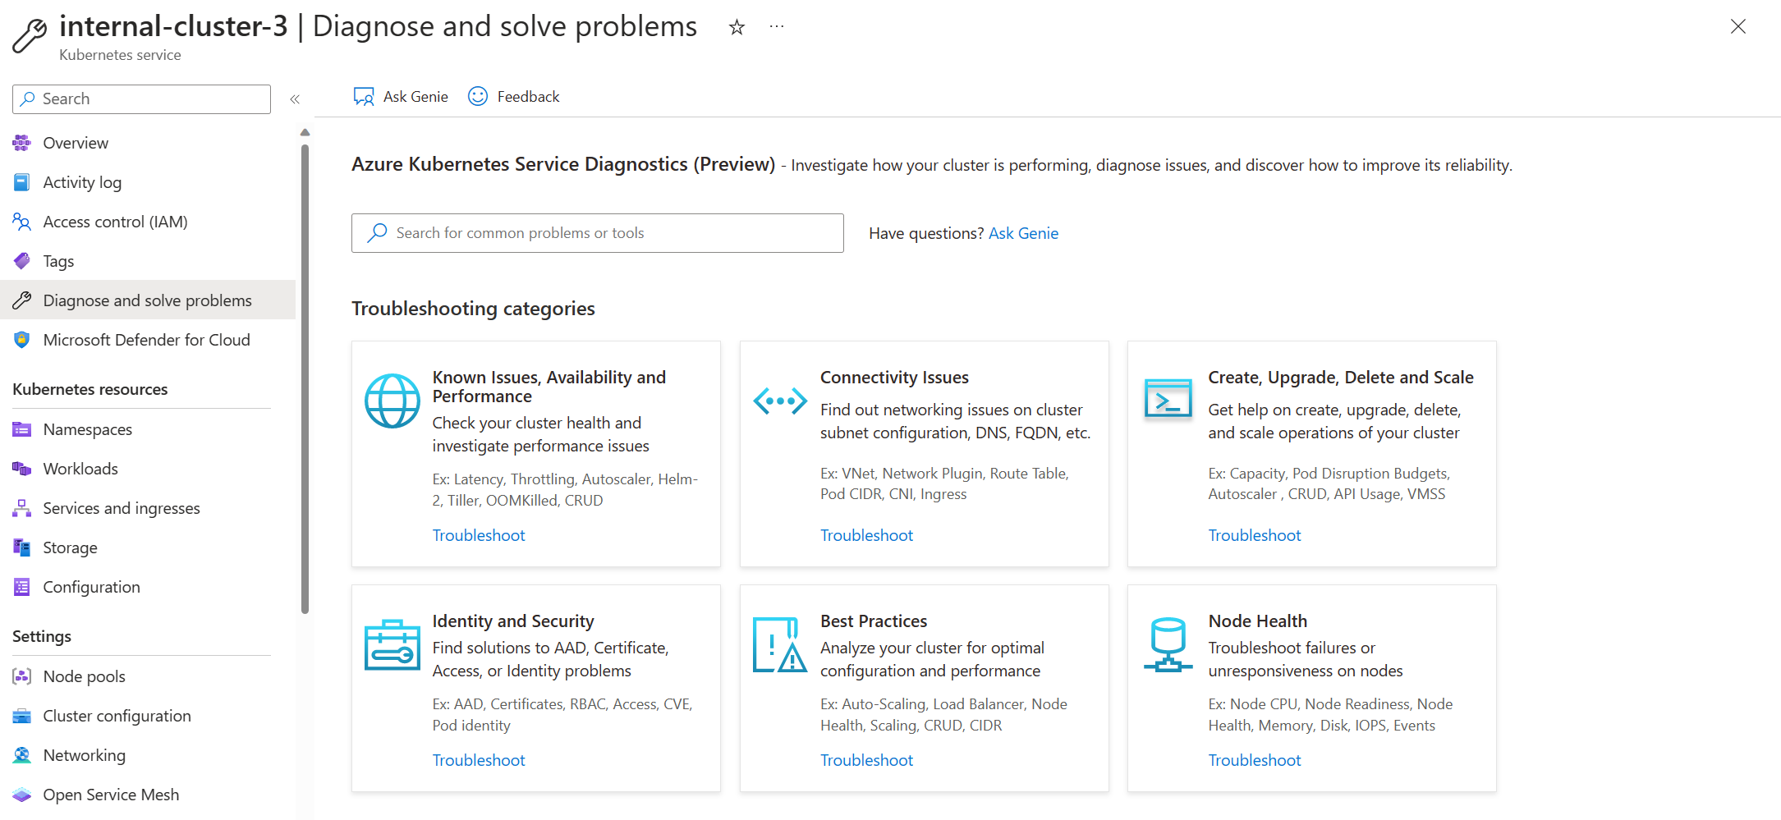
AKS Diagnose and solve problems
No additional cost and out of the box solution for troubleshooting common issues
Review this link for more information

Slide 32
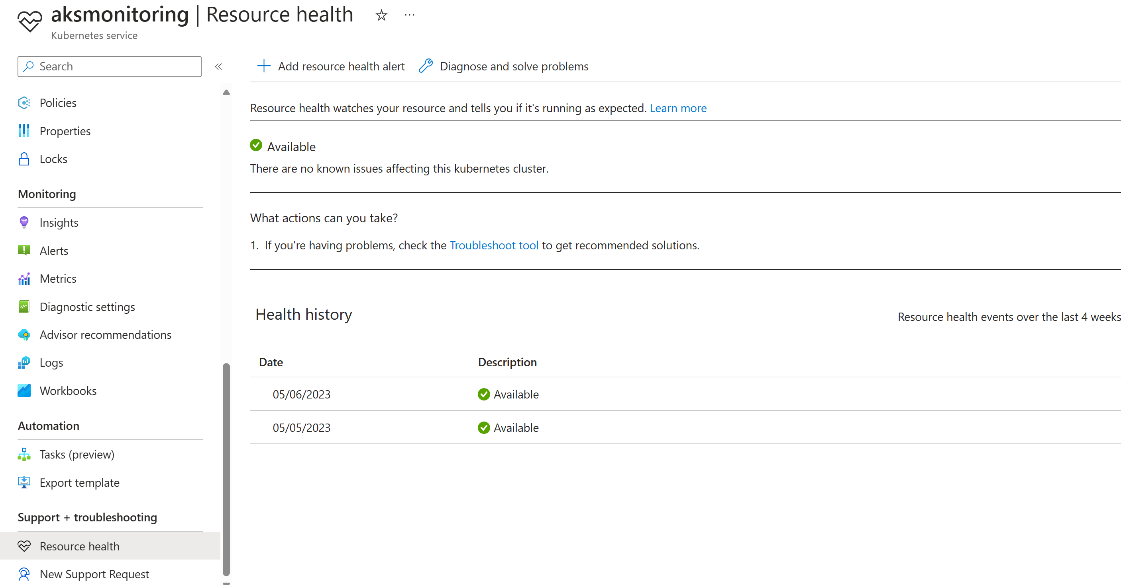
AKS Resource Health
No additional cost and out of the box solution for reporting health status

Slide 33
OpenSource, Tools and 3rd Party solution

Slide 34

Observability - OpenTelemetry
OpenCensus and OpenTracing merged in 2019
Standardized vendor-agnostic SDK, APIs and tools ingesting, transforming, and sending data to an Observability stack
Microsoft embraces OpenTelemetry and is used in Azure Monitor

Slide 35
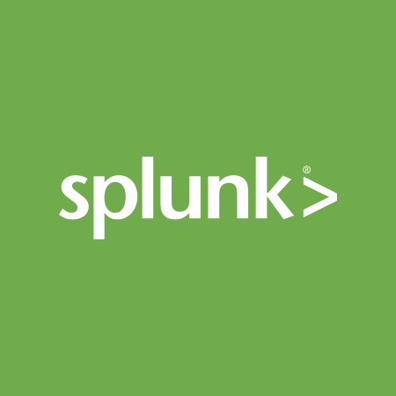



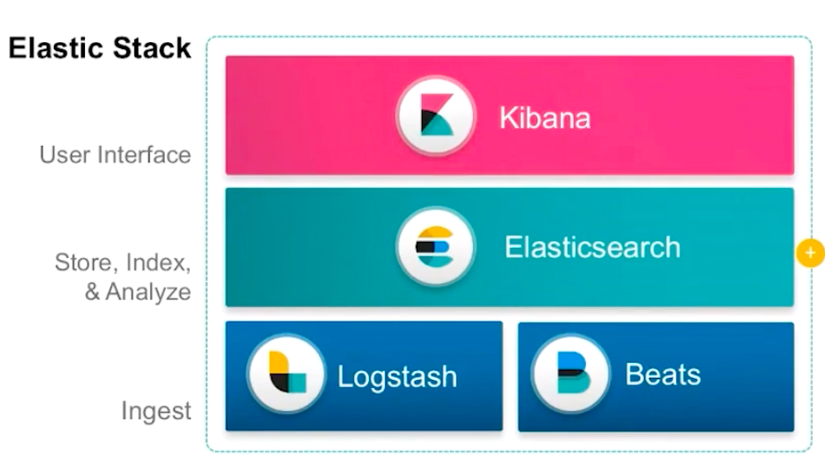



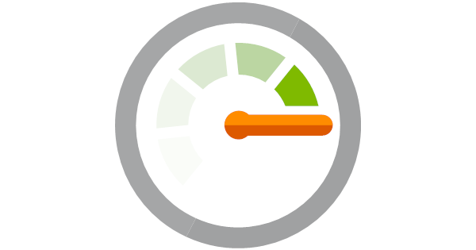

Other monitoring options

Slide 36
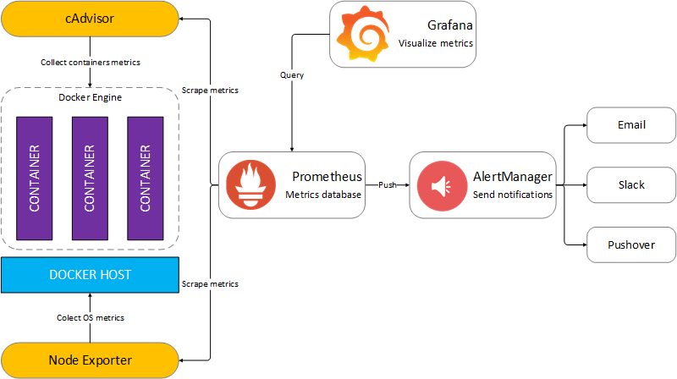
Prometheus + Grafana
Prometheus is an open-source systems monitoring and alerting toolkit
Grafana allows you to query, visualize, alert on and understand your metrics no matter where they are stored.
Azure managed Prometheus for AKS to collect metrics
Azure Managed grafana is available as a separate service for building Dashboards
Notes:
Talk generally about OSS Grafana and Prometheus and why they are heavily used in Kubernetes. Focus mainly on the Manage Services provided by Azure.
We go more into Azure managed options in the next section, but still talk about how they are used here.

Slide 37
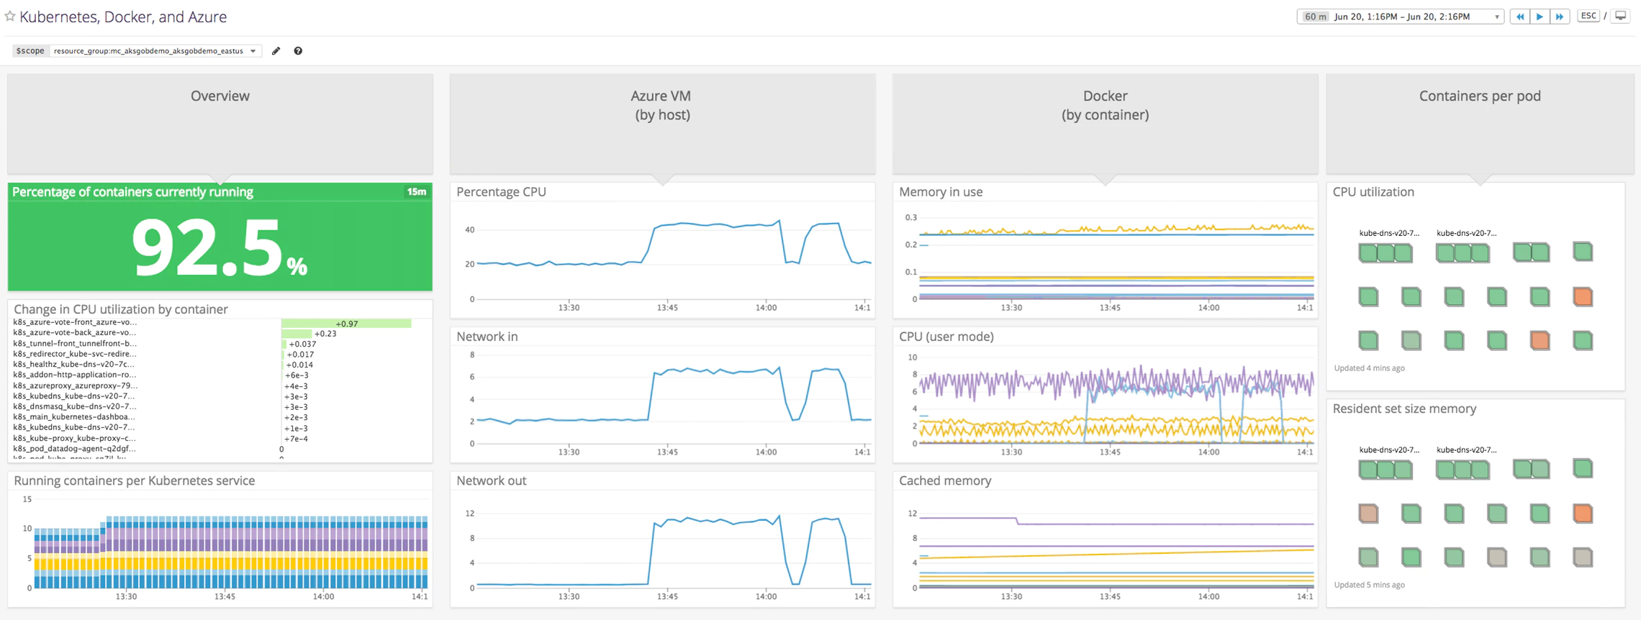
Datadog
Datadog’s integrations with Kubernetes and Azure Monitor provide comprehensive visibility into AKS infrastructure with no additional configuration
To use, you deploy the containerized Datadog Agent as a DaemonSet within your AKS cluster using a provided YAML manifest
https://www.datadoghq.com/blog/announcing-aks/
Notes:
Resources to review:
https://www.datadoghq.com/blog/announcing-aks/
https://www.datadoghq.com/blog/azure-monitoring-enhancements/
Details:
Datadog can help you get full visibility into your AKS deployment by collecting metrics, distributed request traces, and logs from Kubernetes, Azure, and every service running in your container infrastructure
Datadog is introducing a new Live Container view that gives you insight into the status and performance of all your containers in real time

Slide 38
Azure Managed OpenSource Solution

Slide 39
Monitor AKS with Azure Monitor Managed service for Prometheus Container Insights
Notes:
This slide talks about how prometheus works with container insights and ships data to Azure Monitor for it to be used in grafana where alerting and more complex dashboards can be enabled.

Slide 40
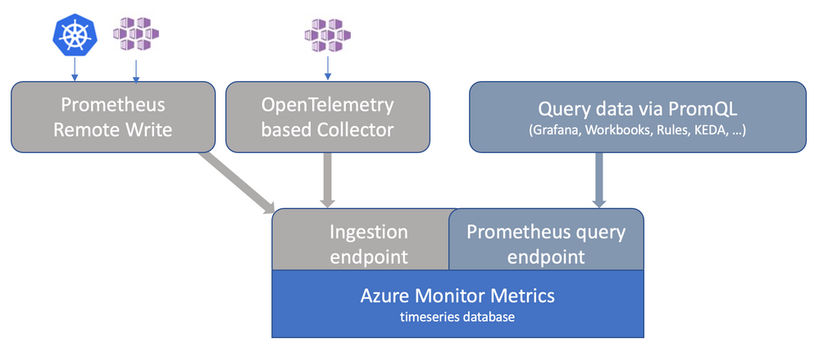
Enable Azure Managed Prometheus
High availability and scaling
az aks update --enable-azuremonitormetrics -n <cluster-name> -g <cluster-resource-group> --azure-monitor-workspace-resource-id <azure-monitor-workspace-name-resource-id> --grafana-resource-id <grafana-workspace-name-resource-id>

Slide 41
Azure Managed Grafana
Azure Managed Grafana is a fully managed service
AMG uses Azure AD as IdP
AMG uses Azure Managed Workspace as data source and can use managed identity to access Azure data sources (including AMW)
  AMG managed identity needs ‘Monitoring Data Reader’ role to Azure Monitor Workspace
Azure Monitor Workspace collects data from
  AKS
  Any K8S with self-managed Prometheus using remote-write

Slide 42
Monitor AKS with Azure Monitor Managed service for Prometheus and Container Insights - Setup
Enable Managed Identity for your AKS Cluster
Create an Azure Monitor Workspace
The following resource providers must be registered in the subscription of the AKS cluster and the Azure Monitor Workspace.
  Microsoft.ContainerService
  Microsoft.Insights
  Microsoft.AlertsManagement
Send Prometheus data to Azure Monitor Logs
Query Prometheus Metrics in Log Analytics Workspace
Create Prometheus Rules

Slide 43
Additional topics
Notes:
If the customer requires Istio the CSA can deliver this next section or just hide it if its not relevant.

Slide 44
Observability with Istio

Slide 45
Istio
Automatic metrics, logs and traces
Intra-cluster traffic, ingress and egress
Integration with OSS based Prometheus and Grafana (or Microsoft managed Prometheus and Grafana)
Integration with Jaeger or Zipkin

Slide 46
Metrics scrapping
az aks update --enable-azure-monitor-metrics --name aksistio1 --resource-group aksistiorg --azure-monitor-workspace-resource-id $amwrid --grafana-resource-id $amgrid
https://learn.microsoft.com/en-us/azure/azure-monitor/containers/prometheus-metrics-scrape-default

Slide 47
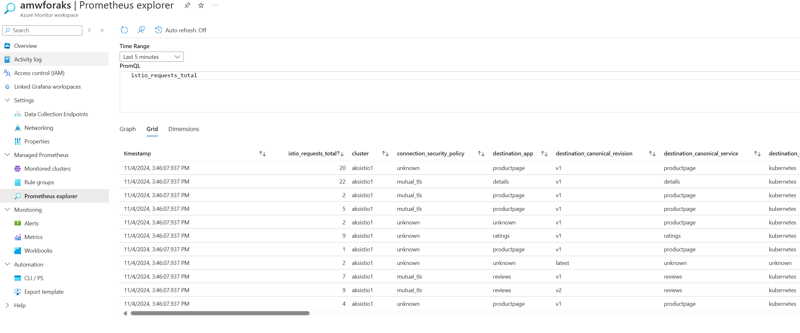
Metrics scrapping – Verify in AMW

Slide 48
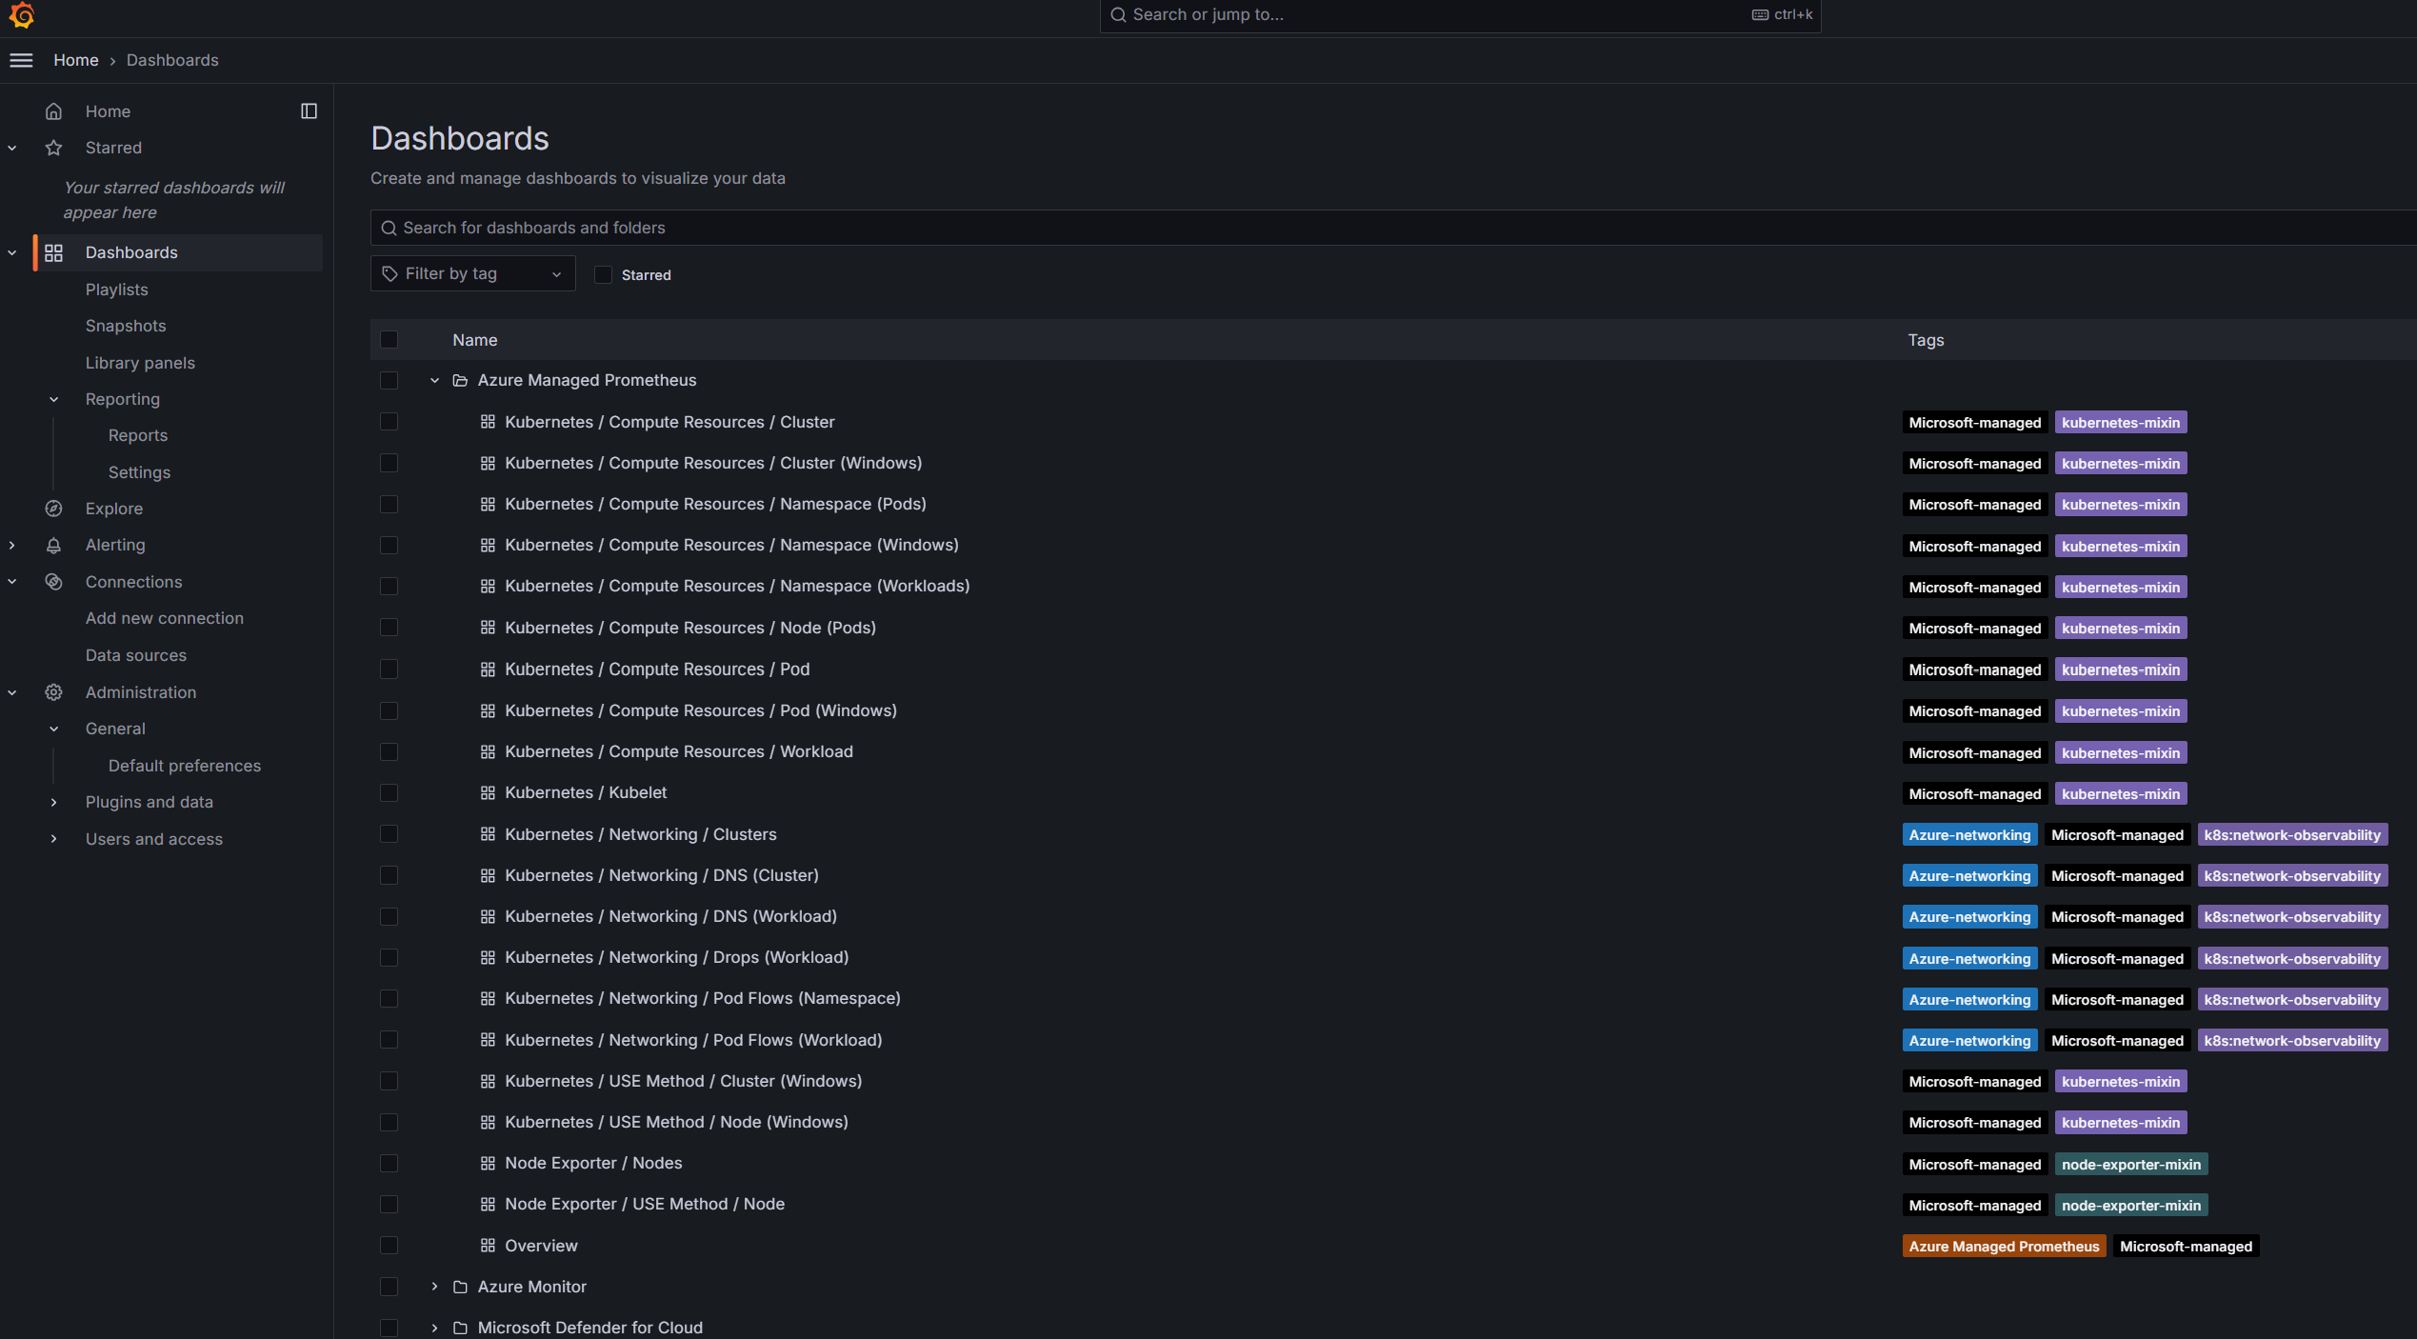
Metrics scrapping – Grafana Dashboards for K8S

Slide 49
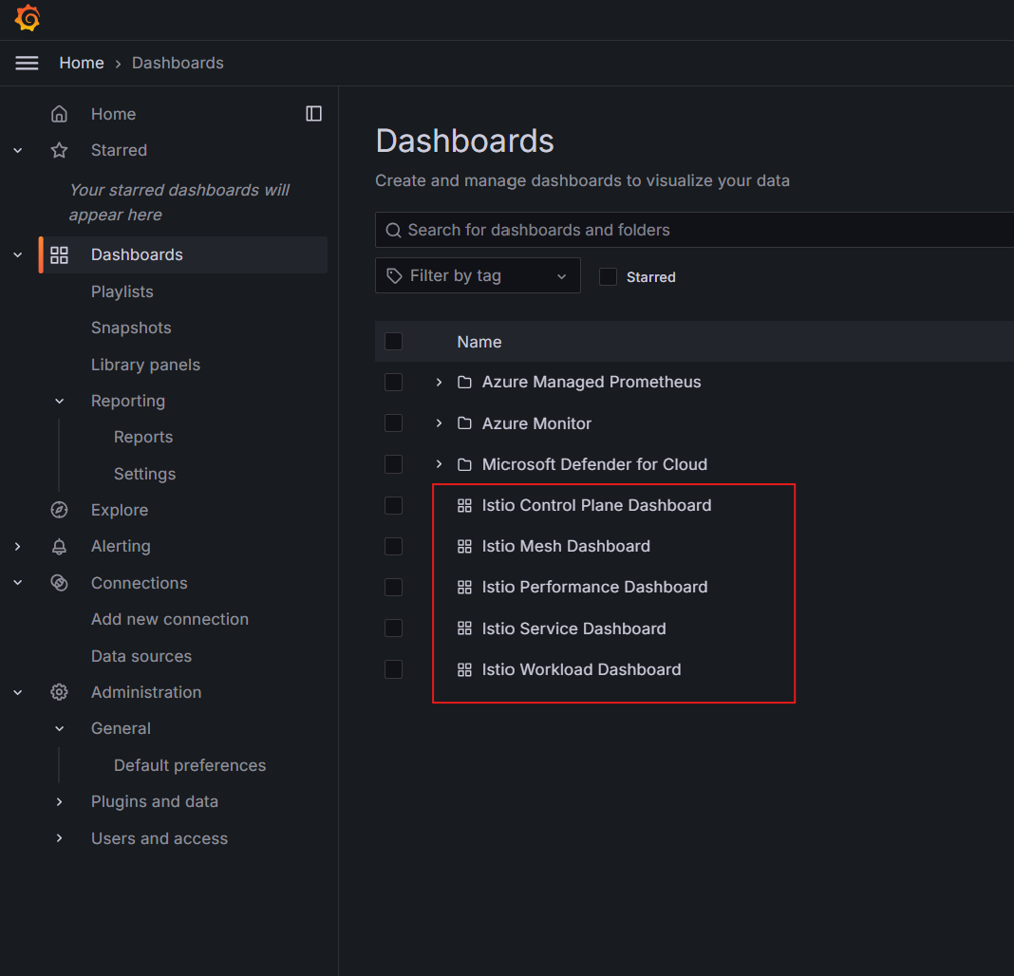
Metrics scrapping – Grafana Dashboards for Istio

Slide 50
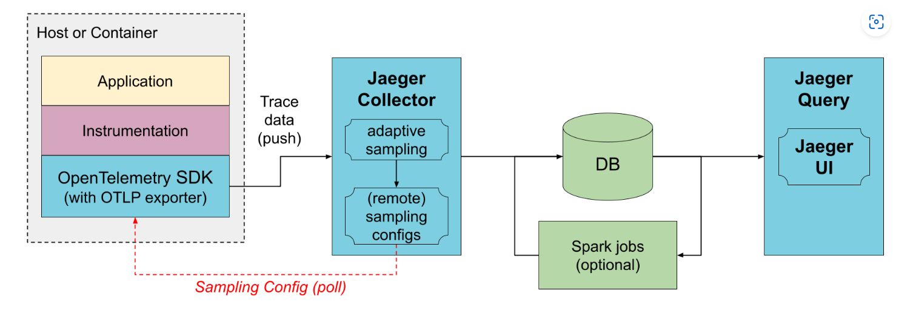
Jaeger – Distributed tracing with Istio
Istio leverages Envoy’s distributed tracing feature to provide tracing integration out of the box
Configures proxies to send trace spans to various tracing backends – Jaeger is one of them
Application must propagate this information in HTTP headers
from jaegertracing.io

Slide 51
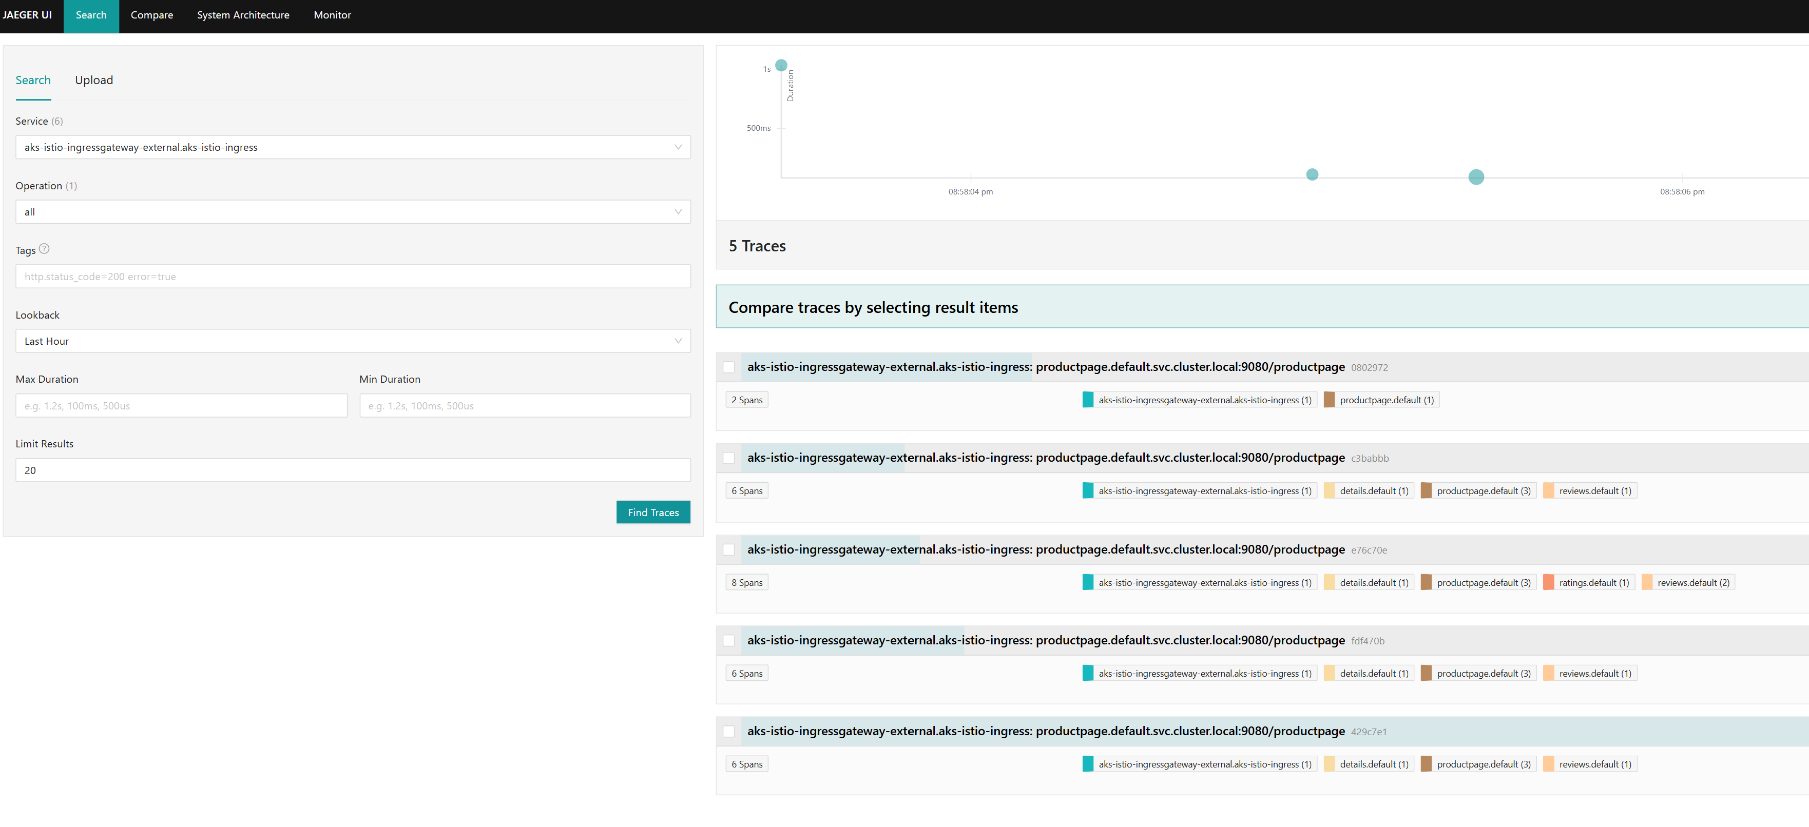
Jaeger – Distributed tracing with Istio

Slide 52
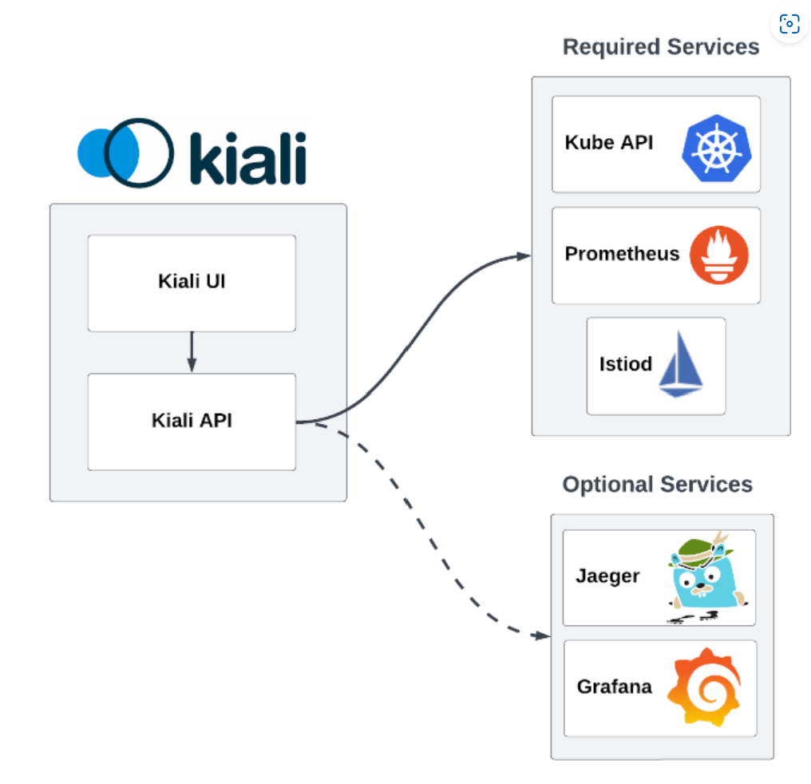
Kiali – Topology view of Istio Service mesh
Kiali is an observability console for Istio with service mesh configuration and validation capabilities.
Kiali uses the data stored in Prometheus to figure out the mesh topology, show metrics, calculate health
from kiali.io

Slide 53
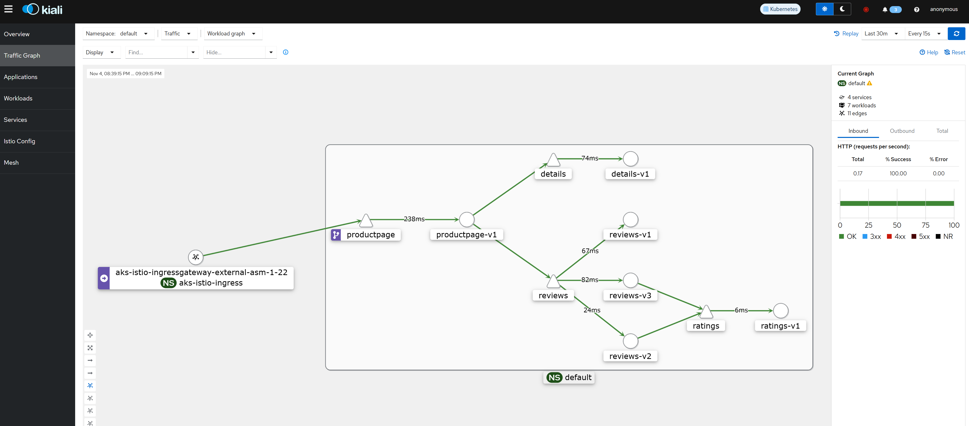
Kiali – Traffic Graph

Slide 54
Questions?

Slide 55

Lab – Module
Monitoring

